Slide 1
Simple Shooter
Part 3
by TommyX

Slide 2
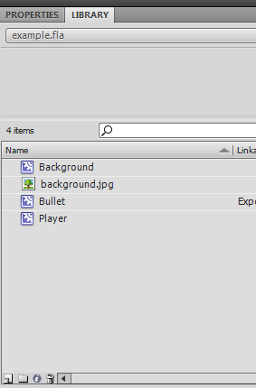
Creating Targets
Lets create the symbol for enemy target. The process is similar to creating a bullet.
Start off by creating a new symbol.
Click here to create a new symbol.

Slide 3
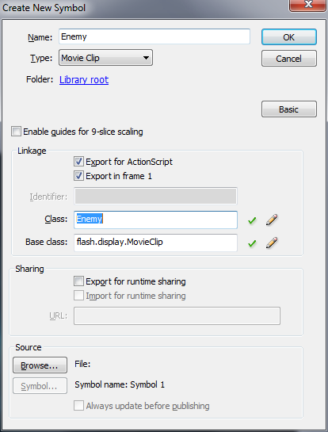
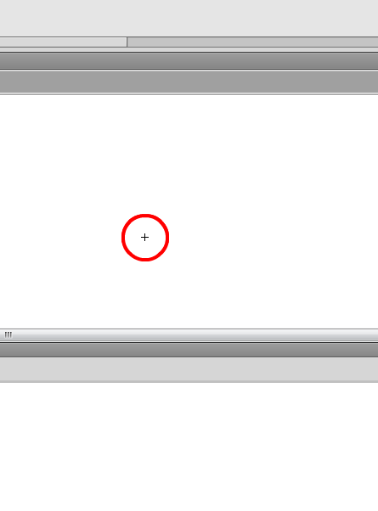
Creating Targets
Assign a library name and a class name.
Then draw the object or use an image.

Slide 4
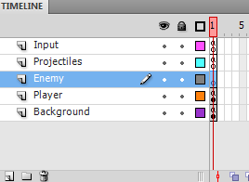
Creating Targets
Lets create a new layer to manage our enemies.
Then, click on the frame of that layer to change the code.
Click here to create a new layer.
Double click to change layer name. Drag to arrange them.

Slide 5
Creating Targets
Similar to spawning bullets, lets create a function called spawnEnemy. We will pass in the position for the enemy.
function spawnEnemy(posX:Number, posY:Number){
}

Slide 6
Creating Targets
Now lets create our enemy object using its class constructor. We initialize its position to the position we pass in. After that, we add the object to the display list.
function spawnEnemy(posX:Number, posY:Number){
var enemy:Enemy = new Enemy()
enemy.x = posX
enemy.y = posY
addChild(enemy)
}

Slide 7
Creating Targets
Lets setup the loop function for the enemy object, and add an event listener for it.
function spawnEnemy(posX:Number, posY:Number){
var enemy:Enemy = new Enemy()
enemy.x = posX
enemy.y = posY
addChild(enemy)
function loop(event){
}
enemy.addEventListener(Event.ENTER_FRAME, loop)
}

Slide 8
Creating Targets
Lets create a property health under the enemy object, just like the properties x, y or rotation. To do that, simply try setting the property to a value. The property will be created automatically.
function spawnEnemy(posX:Number, posY:Number){
var enemy:Enemy = new Enemy()
enemy.x = posX
enemy.y = posY
addChild(enemy)
enemy.health = 100
function loop(event){
}
enemy.addEventListener(Event.ENTER_FRAME, loop)
}

Slide 9
Creating Targets
The enemy object will be removed from the stage if its health drops below zero.
function spawnEnemy(posX:Number, posY:Number){
var enemy:Enemy = new Enemy()
enemy.x = posX
enemy.y = posY
addChild(enemy)
enemy.health = 100
function loop(event){
if (enemy.health <= 0){
enemy.parent.removeChild(enemy)
enemy.removeEventListener(Event.ENTER_FRAME, loop)
}
}
enemy.addEventListener(Event.ENTER_FRAME, loop)
}

Slide 10
Adding Targets to Array
In order to let our bullets hit one of the targets, we must first organize our targets into some kind of list, and then each bullet will loop through the list to see if it collided with one of the targets.
The list in AS3 is called Array. Array is a special type of variables that stores multiple values in order. Each value has an index numbered from 0 to the length of array minus 1. For example, an array [2,6,4,3,1] has length 5, and the elements is numbered 0,1,2,3,and 4.
Index | 0 | 1 | 2 | 3 | 4
value | 2 | 6 | 4 | 3 | 1

Slide 11
Adding Targets to Array
Lets create an array at the root level (not inside the spawnEnemy function).
To create an array, simply create an variable with type Array, and its value can be represented by list of items enclosed in square bracket and separated by comma (ex. [2,6,4,3,1]). In this case we will create an empty array.
var enemyList:Array = []
function spawnEnemy(posX:Number, posY:Number){
…blah blah blah

Slide 12
Adding Targets to Array
To add things to the array, we use its function (AKA method) push(value). This add an element to the end of the array, thus increasing its length by one.
var enemyList:Array = []
function spawnEnemy(posX:Number, posY:Number){
var enemy:Enemy = new Enemy()
enemyList.push(enemy)
enemy.x = posX
enemy.y = posY
addChild(enemy)
enemy.health = 100
function loop(event){
…blah blah blah

Slide 13
Adding Targets to Array
When the enemy is removed from the stage, it should also be removed from the array.
The function indexOf(value) can return the first index of an element in the array. The function splice(index, numberOfElementToDelete) can delete one or more elements in the array. We will use them to remove the enemy object.
…blah blah
if (enemy.health <= 0){
enemyList.splice(enemyList.indexOf(enemy), 1)
enemy.parent.removeChild(enemy)
enemy.removeEventListener(Event.ENTER_FRAME, loop)
}
…blah blah

Slide 14
Checking bullet collision
Lets go to our projectile layer’s frame and edit the code for bullets.
In the loop function for each bullet, we want to loop through each enemy and check for collision. Lets write a for loop(more info: http://www.republicofcode.com/tutorials/flash/as3loops/) that loop through all the indexes in the array.
…blah blah
bullet.x += speed
for (var i = 0; i < enemyList.length; i++){
}
if (bullet.x > stage.stageWidth){
…blah blah

Slide 15
Checking bullet collision
To access an item in the array using index, simply write array[index]. For example, to access the 4th item in array “myList”, write myList[3] (remember 0 is the first index).
To check for collision between an object and a point, write object.hitTestPoint(pointX, pointY), which will return true if the point is inside the object.
…blah blah
bullet.x += speed
for (var i = 0; i < enemyList.length; i++){
if (enemyList[i].hitTestPoint(bullet.x, bullet.y)){
}
}
if (bullet.x > stage.stageWidth){
…blah blah

Slide 16
Checking bullet collision
If the bullet hit one of the enemies, the health of the enemy should be reduced. We can use a variable to store the damage.
After decreasing target’s health, we should remove the bullet.
…blah blah
bullet.x += speed
for (var i = 0; i < enemyList.length; i++){
if (enemyList[i].hitTestPoint(bullet.x, bullet.y)){
enemyList[i].health -= 50
bullet.parent.removeChild(bullet)
bullet.removeEventListener(Event.ENTER_FRAME, loop)
}
}
if (bullet.x > stage.stageWidth){
…blah blah

